Slide 1
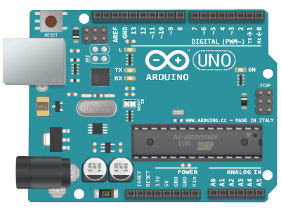
What is a Microcontroller?
A microcontroller is a compact integrated circuit designed to govern a specific operation in an embedded system.
A typical microcontroller includes a processor, memory and input/output (I/O) peripherals on a single chip.

Slide 2
Microcontroller vs Microprocessor
Chip with dedicated operation
General Purpose Device
1
Contains I/O ports, timer, RAM, ROM
Doesn’t contain I/O ports, timer, RAM, ROM
2
Bit addressable as well as byte addressable
Byte addressable and nibble addressable
3
Instruction set is simple with less number of instructions
Instruction set is complex
4

Slide 3
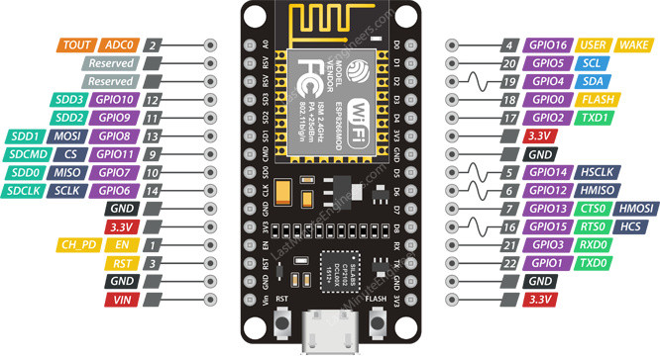
Introduction to NodeMCU

Slide 4
( GPIO Pins )
General
Purpose Input Output

Slide 5
( Power Pins )
Positive 3.3 V ,
Ground

Slide 6

Time to install
Arduino IDE

Slide 7
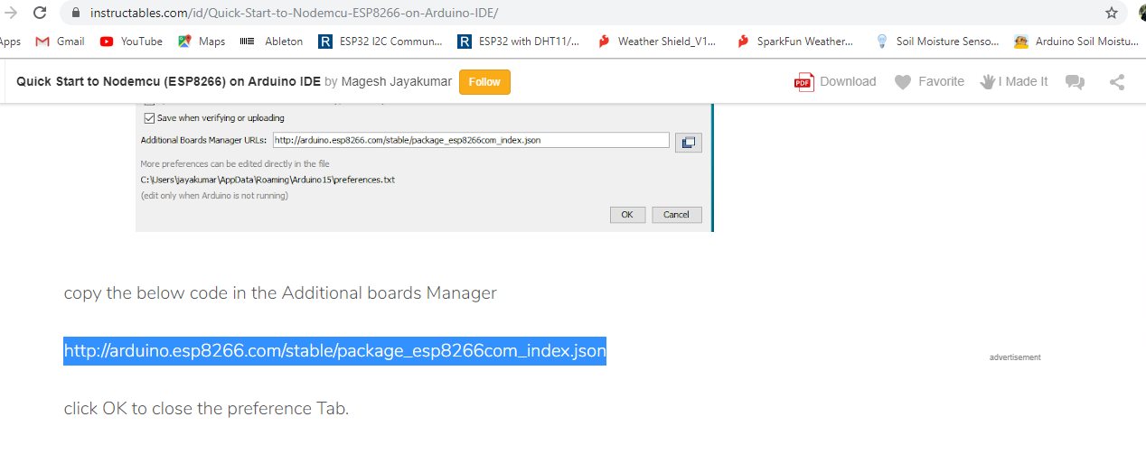
Configuration of NodeMCU
1

Slide 8
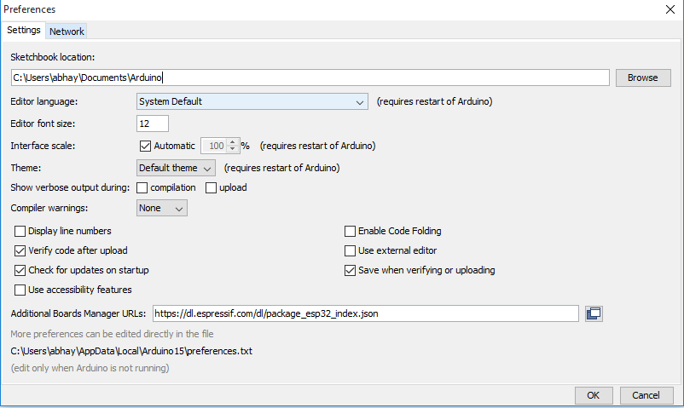
Configuration of NodeMCU
2

Slide 9
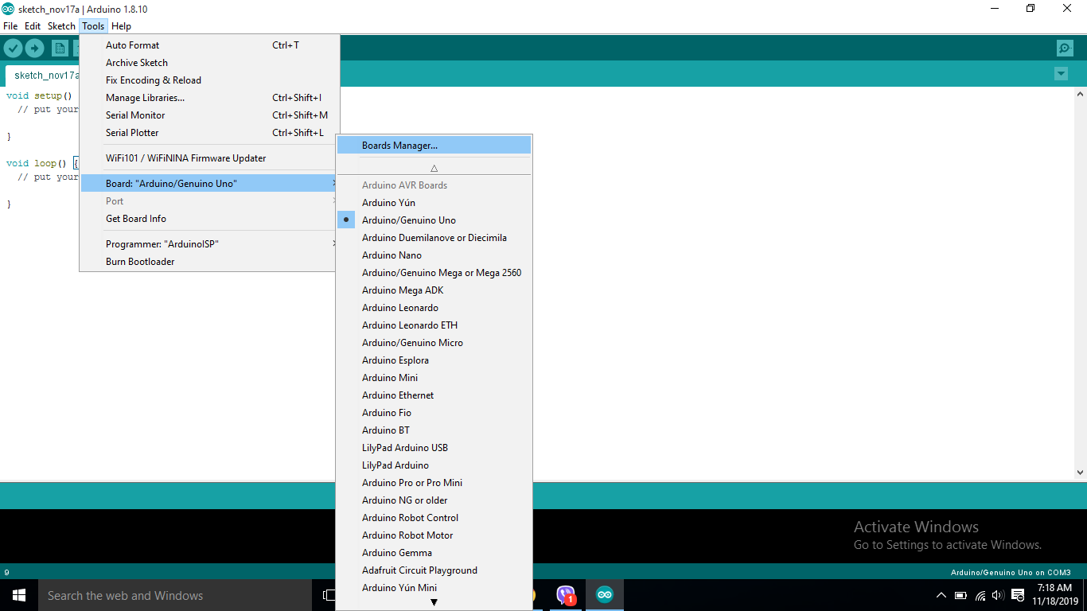
Configuration of NodeMCU
3

Slide 10
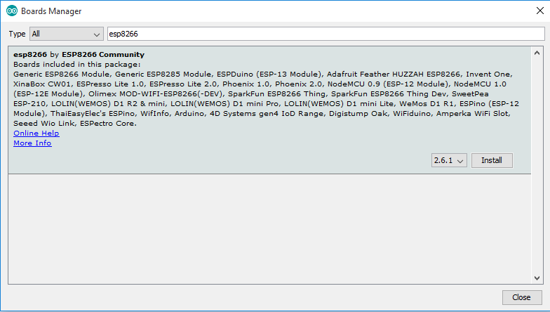
Configuration of NodeMCU
4

Slide 11
Arduino IDE
Overview

Slide 12
Embedded C in Arduino
Program Structure

Slide 13
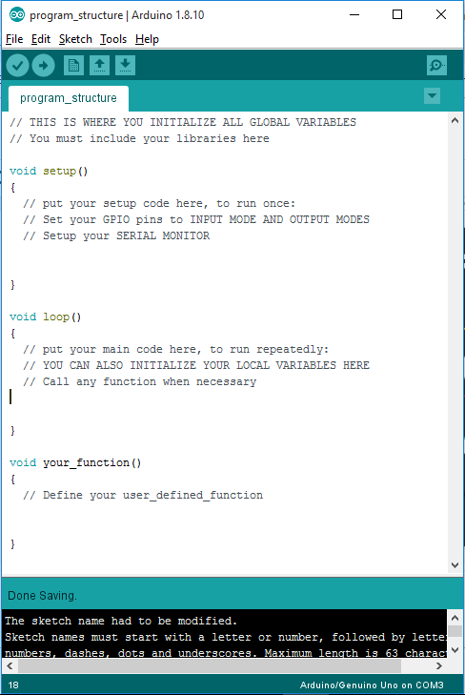
1 Declaration and Initialization
2 Setup
3 Main loop
4 User-defined function
5 Verification

Slide 14
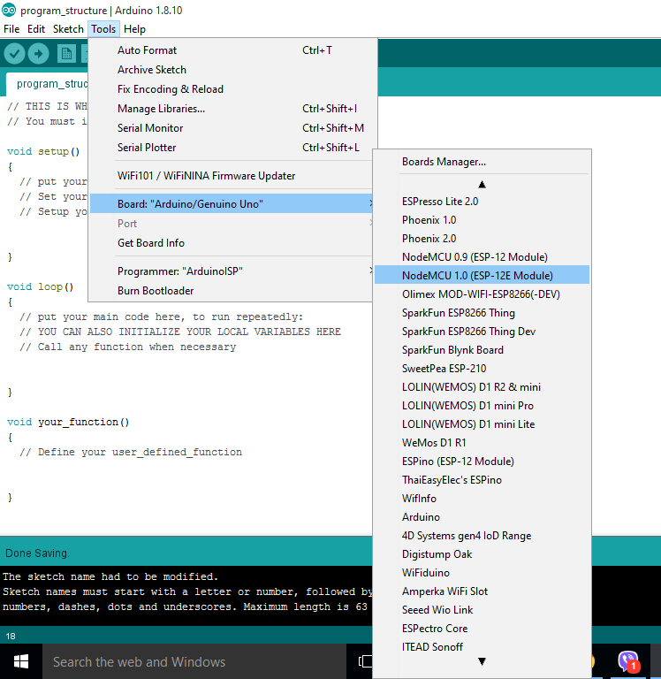
Select your Microcontroller

Slide 15
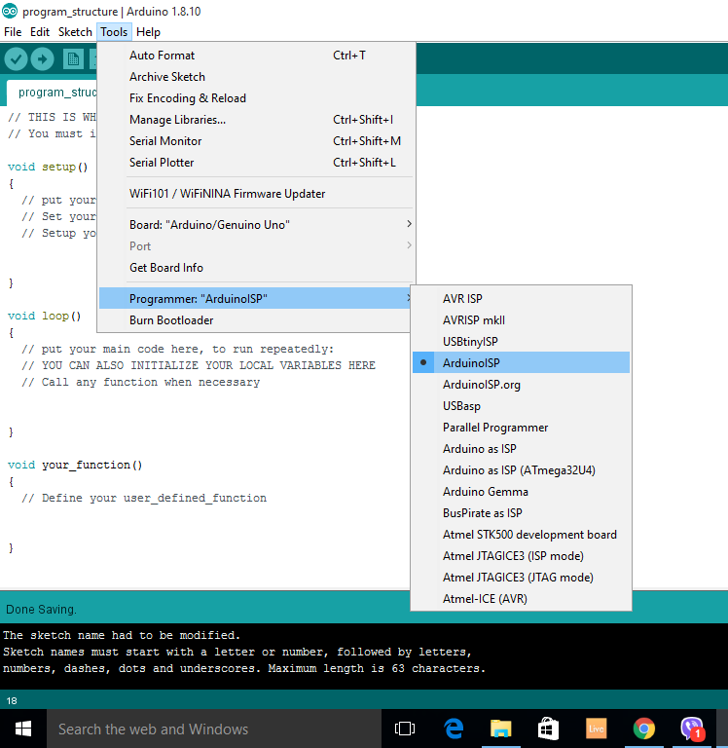
Select the programmer

Slide 16
Upload your code to the Microcontroller

Slide 17
Our First Code
Let’s blink an LED

Slide 18
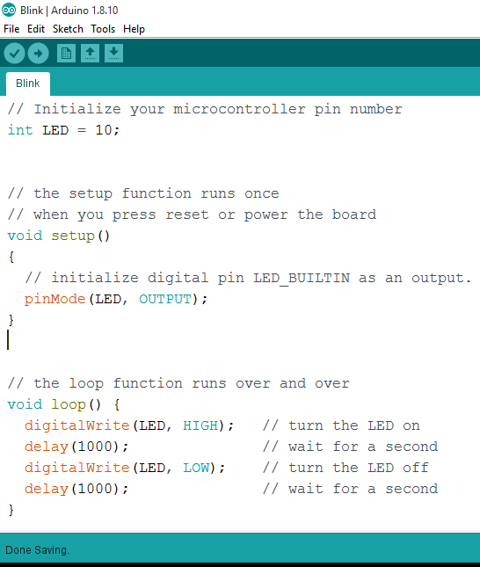
1 pinMode ( )
2 digitalWrite ( )
3 delay ( )

Slide 19
That’s all for Day 1
Thank you

